Slide 1


CRISP - DM
CRoss Industry Standard Process for Data Mining
Deployment - Phase
Data Engineering
Assignment-2
Mar 8th ,2022
Suganya AM

Slide 2
01
CRISP-DM
02
DEPLOYMENT
03
IMPLEMENTATIONS
04
INSIGHTS
05
HYPER CARE
06
CASE STUDY
07
CONCLUSION
CONTENTS

Slide 3
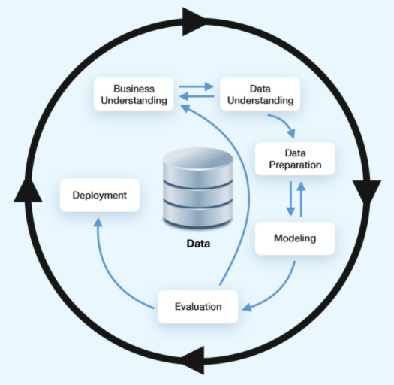
process model used by data mining experts widely used analytics model describes Data science Life Cycle has six phases DEPLOYMENT PHASE Deployment is the final step for Data Science Projects

Slide 4


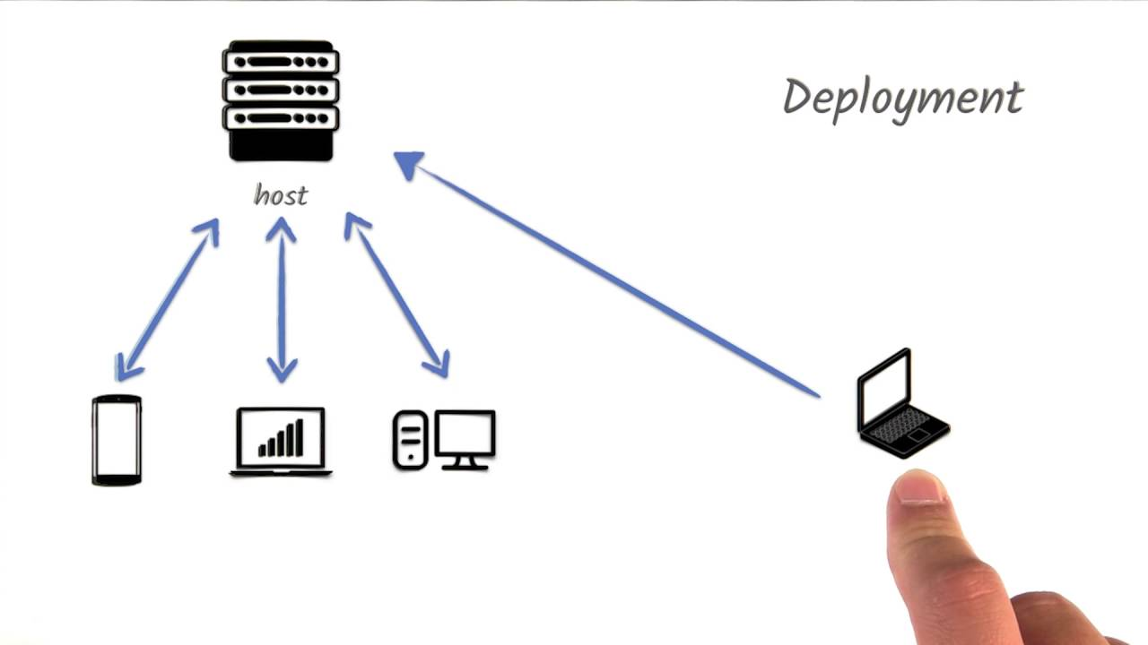
Deployment
Depending on the requirements, the deployment phase can be simple as generating a report or as complex as implementing a repeatable data mining process across the enterprise.
Whatever the case, easy access to the data mining results must always be granted to the stakeholders.

Slide 5


Once the model is trained, tuned and tested, it gets deployed into production and makes inferences (predictions) against the model
Need not to have a heavy instance for inference on new (unseen) data to make predictions except for Real Time Streaming Data which is needs continuous re-training
Use case for One-time Implementation: Finding why students are under performing in a school in US.
Use case for Real Time Streaming Data Implementation:
Recommendation Systems in Netflix
Sales expectations and subsequent predictions may change due to new user competition

Slide 6
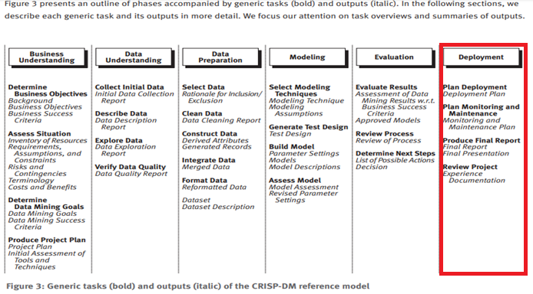
Deployment has 4 tasks:
Plan deployment
Develop and document a plan for deploying the model.
Plan monitoring and maintenance
Develop a thorough monitoring and maintenance plan to avoid issues during the operational phase (or post-project phase) of a model.
Produce final report
The project team documents a summary of the project which might include a final presentation of data mining results.
Review project
Conduct a project retrospective about what went well, what could have been better, and how to improve in the future.

Slide 7
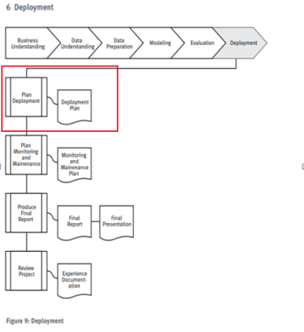
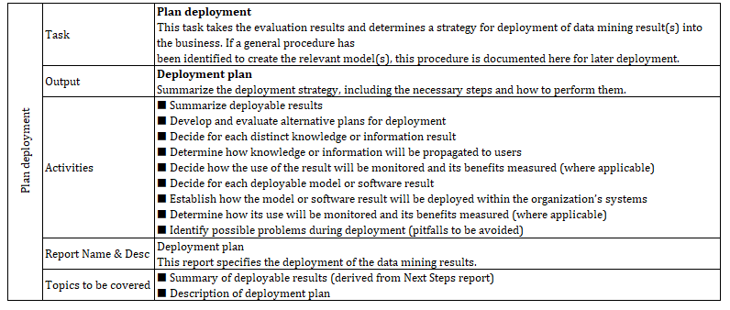

Slide 8
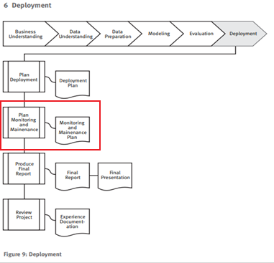
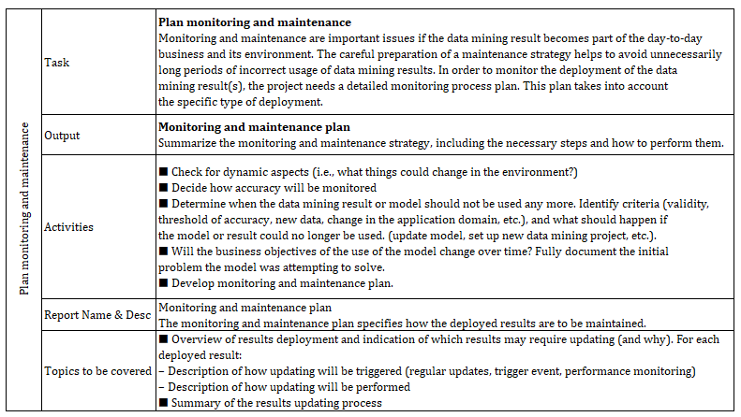

Slide 9
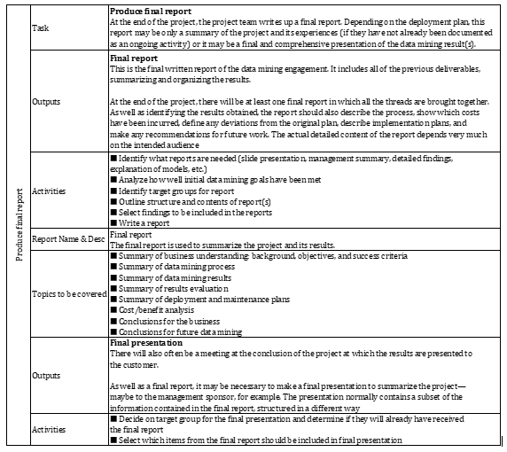
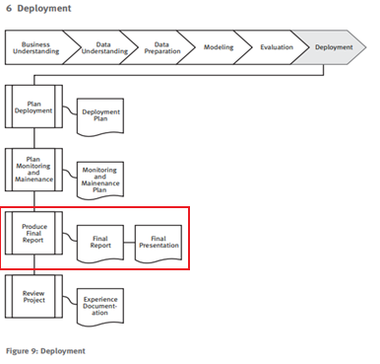

Slide 10
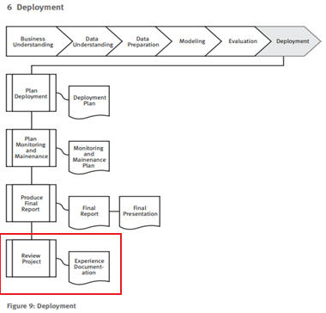
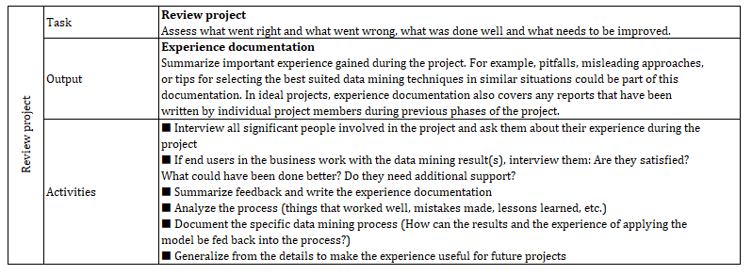

Slide 11

Model must be maintained in production, also known as “operations”.
Constant monitoring and occasional model tuning is often required.
Data mining does not end once a solution is deployed. The lessons learnt during the process and from the deployed solution can trigger new, often more-focused business questions.

Slide 12




Once the model is ready, it will be released to end users
Deploying is where we release model for public use in a centralized location
Multitudes of ways where the model could be deployed
On Cloud like aws, Google Cloud, or Microsoft Azure etc
On Premise Hardware
Hypothetical Use case:
User provides inputs based on given criteria's and the data flows into the model, runs behind the screen ,and the output results as “PR will be received in 10 months”

Slide 13

BEST PRACTICES WHILE DEPLOYING MODELS IN PRODUCTION
Monitor Model performance in production and compare to business expectations
Monitor differences between model performance during training and in production
When changes in model performance are detected, re-train the model.
For example, sales expectations and subsequent predictions may change due to new user competition.
After an ML model is deployed in production, the real world data might start to differ from the data that was used to train the model leading to deviations in model quality and eventually to less accurate models.
Build a Model monitor that detects Data drift which can degrade the model performance over time and alerts us to take remedial actions
Always consider building feature data processing and feature engineering pipelines with suite of feature transformers readily available in Spark ML, Scikit Learn Framework containers and deploy these as part of inference pipelines to re-use data processing codes. This will simplify the management of ML Processes and continuous monitoring.

Slide 14
CASE STUDY -Using Data Mining to Detect Insurance Fraud
Once you have models that predict fraudulent activity, you need to strategically deploy your results to those who can use that information to eradicate fraud and recoup the money. Deployment means integrating models into your company’s daily operations.
IBM® SPSS Decision Management enables you to score values against new claims and payment requests, then deploy your model and distribute the results (for example, a list of claims most likely to be non-compliant).
Depending on needs, these results are displayed over an intranet, through e-mail or via hard-copy reports.
The data-mining team meets to discuss how much data during the process was successfully identifying fraud and abuse and what are the best practices they need to follow in future and what should be avoided during the process.
Consistently monitored. Any decline in model performance will be detected
The team will identify how the current system is behaving and where they are finding the decline in the performance in the system.
All the reports include the performance of the system up to this point and an overview outlining the fraud detection system and its summary to be shared with management.

Slide 15
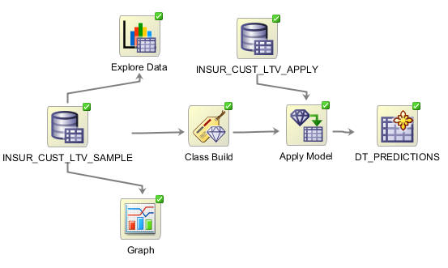
A Sample Deployment Tool Study
Oracle Data Mining (ODM )Scoring Engine used for exporting and importing models from one environment to another using impdp, expdp utility.
ODM interfaces has also calls that is used for import export models.
DBMS_DATA_MINING.export_model()
DBMS_DATA_MINING.import_model()

Slide 16


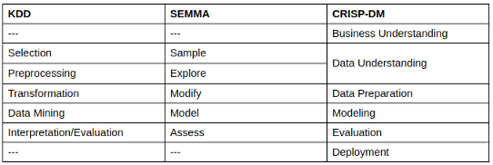
ALTERNATIVE DATA SCIENCE PROJECT MANAGEMENT METHODOLOGIES
SEMMA
Sample, Explore, Modify, Model and Access
KDD
Knowledge Discovery in Databases

Slide 17
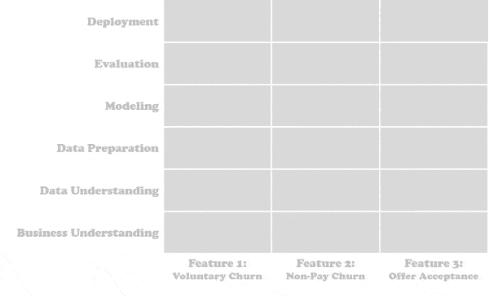
Combining CRISP - DM with Agile, will yield best results

Slide 18
RESOURCES
https://www.datascience-pm.com/crisp-dm-2/
https://www.the-modeling-agency.com/crisp-dm.pdf
https://www.ibm.com/docs/en/spss-modeler/SaaS?topic=dm-crisp-help-overview
https://www.sv-europe.com/crisp-dm-methodology/
https://docs.oracle.com/en/database/oracle/oracle-database/19/tutorial-create-dm-workflow/index.html

Slide 19
THANKS !

